Slide 1
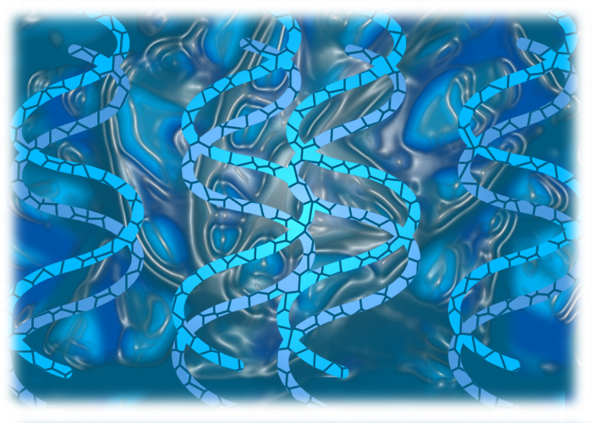
Module 1
Biotechnology Basics
Copyright © Texas Education Agency 2009. All rights reserved.
Notes:
Welcome to the TEA certification course for advanced biotechnology. This project is designed to give science and technology high school teachers in the state of Texas an opportunity to obtain certification for teaching advanced biotechnology as a course for science credit. This online curriculum will provide teachers with an overview of the biotechnology field and an introduction to the latest information and discoveries in biotechnology. This curriculum will be divided into four modules. The first module will lay the groundwork by providing you with the background information necessary to understand the latest discoveries in biotechnology.

Slide 2
Lessons for Module 1
1.1 Overview of Biotechnology
1.2 Cell Structure and Function
1.3 DNA Structure and Function
1.4 Protein Synthesis
1.5 Protein Structure and Function
1.6 Math Skills
1.7 Lab Overview
Copyright © Texas Education Agency 2009. All rights reserved.
Notes:
This first module is divided into 7 lessons. There will be a test at the end of each lesson and you are required to pass each test with an 80% average or better to be certified to teach advanced biotechnology. The first lesson will give you an overview of the history and definition of biotechnology. The second lesson will describe the structure and function of a cell. The third lesson explains the structure and function of DNA. The fourth lesson describes the process whereby DNA becomes protein. The fifth lesson details what a protein is and what a protein does. The sixth lesson reviews the basic math skills needed by a biotechnician. The last lesson in this module will help you understand how a biotechnology lab is set up and how to facilitate a biotechnology class.

Slide 3
Goals for Lesson 1.1
Define biotechnology
Understand the history of biotechnology
Relate biotechnology to current world issues
Copyright © Texas Education Agency 2009. All rights reserved.
Notes:
Let’s get started with lesson one. The goals for this lesson are to define biotechnology, learn about the history of biotechnology, and relate biotechnology to current world issues.

Slide 4
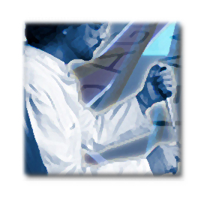
Define Biotechnology
The use of living organisms and biological molecules to solve problems or make useful products.
Copyright © Texas Education Agency 2009. All rights reserved.
Notes:
We think of biotechnology as a relatively new field of science, but the word “biotechnology” was first used in 1919 by a Hungarian engineer. He used it to describe using another living organism for one’s own benefit. By this definition, biotechnology is not new. In fact, it dates all the way back to the very beginnings of civilization.

Slide 5
History of Biotechnology
Fermentation
Copyright © Texas Education Agency 2009. All rights reserved.
Notes:
From the beginning of time, agriculture has concentrated on improving food production. The earliest and most familiar bioprocess is microbial fermentation. Fermentation is a metabolic process where by-products of glucose metabolism, carbon dioxide and lactic acid, can be used to leaven bread, produce yogurt and cheese from milk, wine from sugars and brew beer from starches.

Slide 6
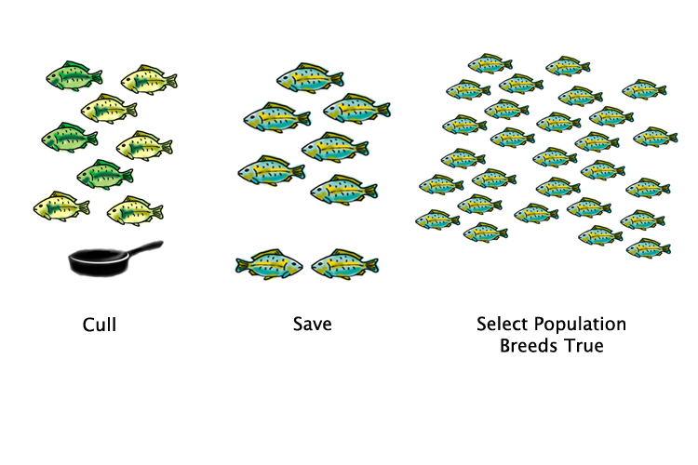
History of Biotechnology
Selective breeding
Copyright © Texas Education Agency 2009. All rights reserved.
Notes:
For thousands of years humans have used an agricultural biotechnology application called selective breeding to cultivate superior crops and livestock that show an improved growth rate or other desirable traits. It is common sense to know that if you breed a male and female with a desirable trait, the offspring will all carry that trait. However, until only a few hundred years ago no one understood the biology behind this common sense. Today, the biotechnology of marker assisted selection (MAS) allows breeders to use biochemical and genetic markers linked to traits of interest to identify superior plants and animals for breeding.

Slide 7
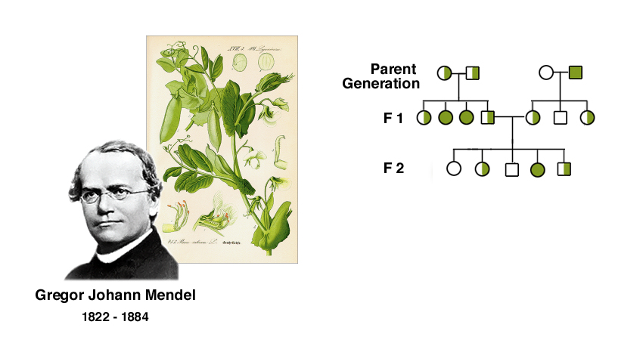
History of Biotechnology
Mendel’s work in genetics
Copyright © Texas Education Agency 2009. All rights reserved.
Notes:
In the 1800’s Gregor Mendel began to study inheritance patterns of a common garden pea. Mendel’s observations led him to believe that some traits were “dominant” and would always be expressed, whereas other traits were “recessive” and would only be expressed if both parents contributed a recessive allele. Mendel’s work went largely unnoticed until the early 1900’s and has since been considered the foundation of population genetics. It is important to note that at this time no one understood that DNA was the mechanism of inheritance. Today the structure of DNA has been elucidated and is exploited for the countless biotechnology applications that will be discussed in this course.

Slide 8
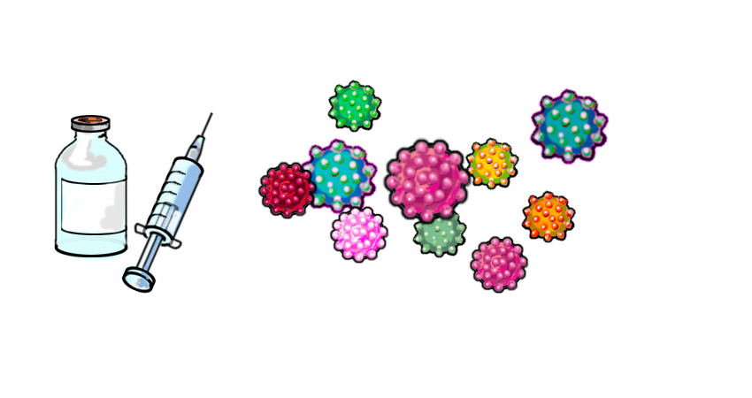
History of Biotechnology
Vaccinations
Copyright © Texas Education Agency 2009. All rights reserved.
Notes:
In the late 18th century Edward Jenner demonstrated that people injected with a live cowpox virus were immune to smallpox. How could that possibly have worked? Well, you have to understand a little bit about the immune system. Antigens are on the surface of all pathogens. A pathogen is a bacteria or virus that that has the potential to cause disease in the host it invades . Your body reacts to these foreign antigens by stimulating white blood cells to produce antibodies that attach to the antigens on the pathogen and mark them for destruction. However, while your body is carrying out this immune response you feel very sick. BUT some of those white blood cells become something called “memory cells” so that if your body ever encounters the same antigen again, these “memory cells” quickly produce large amounts of antibody and attack the invader! So how did Jenner’s vaccination work to protect people from smallpox? Well, the cowpox virus is very similar to the smallpox virus. So while people who received the cowpox injection did not get sick, the cowpox virus did stimulate the immune response and produce memory cells that would recognize the smallpox virus if the person ever came in contact with it. Therefore, the injected people had immunity to the smallpox virus without ever becoming ill with the virus. Today more than 325 million people worldwide have been helped by biotechnology-derived drugs and vaccines.

Slide 9
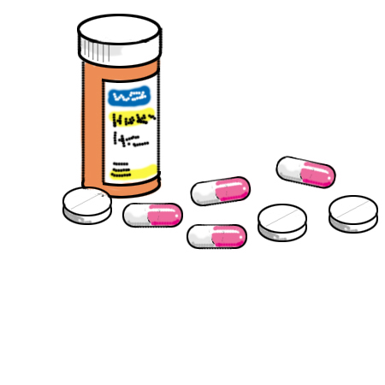
History of Biotechnology
Pharmaceuticals
Copyright © Texas Education Agency 2009. All rights reserved.
Notes:
Another huge advancement for the pharmaceutical industry was the discovery of penicillin. In 1928 Alexander Fleming noticed by accident that certain bacteria would not grow in the proximity of a particular mold. Fleming, being a typically inquisitive scientist, investigated the cause of this phenomenon. Fleming’s research led to the discovery and purification of the first antibiotic, penicillin. Antibiotics work by either directly killing the microorganism or by inhibiting it’s replication. Antibiotics ONLY work for bacterial infections, not for viral infections like colds. Since Fleming’s discovery, many new antibiotics have been produced by the pharmaceutical industry but we still only have a limited number of antibiotics. It is important to maintain the potency of our antibiotics by controlling their misuse and overuse and reminding patients to finish their antibiotic prescription to prevent the mutation of a bacteria resulting in resistance to that particular antibiotic.

Slide 10
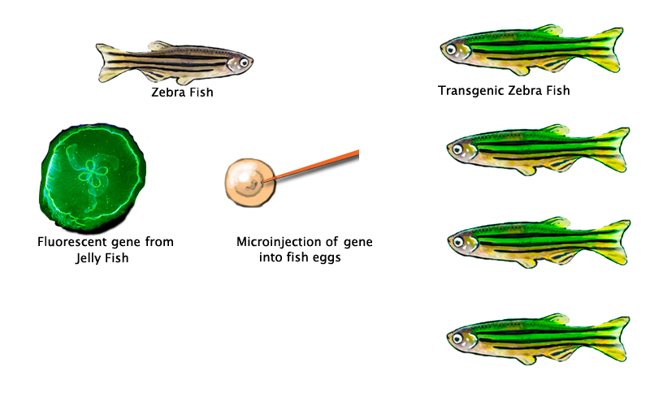
History of Biotechnology
Genetic engineering
Copyright © Texas Education Agency 2009. All rights reserved.
Notes:
When one thinks of modern biotechnology, however, gene engineering and recombinant organisms take center stage. Biotechnology was revolutionized when scientists first learned how to isolate and clone genes and discovered that it was possible to insert these cloned genes in a different organism and have the protein expressed. For example, scientists isolated a gene from jellyfish called the GFP gene. This gene expresses a protein that fluoresces green under UV light and is thus called the Green Fluorescent protein. Scientists have been able to clone this gene into many other organisms, including the fish in this picture, and when the GFP gene is expressed these organisms glow green under UV light! The remainder of this module will explain this exciting biological revolution.

Slide 11
Relating Biotechnology to Current World Issues
Biotechnology is used in:
Agriculture – reducing the use of harmful pesticides
Bioremediation – cleaning up the environment
Food Processing – genetically modified food
Textile industry– enzymes replacing harmful chemicals
Forensics – criminal investigations
Archeology – determine ancestry of mummies and fossils
Medicine – cheaper medicines and diagnostic tests
Copyright © Texas Education Agency 2009. All rights reserved.
Notes:
The purpose of this online curriculum is to show you that regardless of where your interests lie, there is an application for biotechnology. The chart above is merely the tip of the iceberg regarding biotechnology applications in the fields of agriculture, environmental bioremediation, food processing, textile industry, forensics, archeology, and the medical field. The remainder of this module will help you understand the basic concepts of biotechnology so that we can explore the applications listed above in the next three modules and guide you in teaching advanced biotechnology concepts in your classroom.

Slide 12
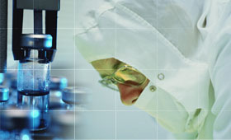
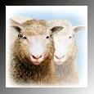
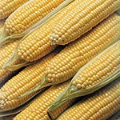
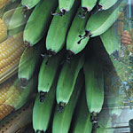
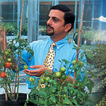
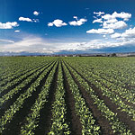
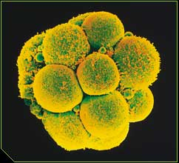
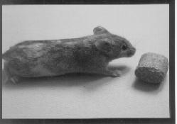
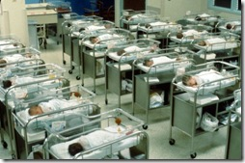
Introductory Biotech Video
Copyright © Texas Education Agency 2009. All rights reserved.
Notes:
This slide is a collage of some topics you have heard about on the news. Biotechnology encompasses a number of controversial topics such as cloning, stem cell research, using animals in research, genetically modified food, and creating “designer babies”. Click on the link “Introductory Biotech Video” to further your understanding of the applications in this exciting field.

Slide 13
Resources
Copyright © Texas Education Agency 2009. All rights reserved.
Notes:
You are now ready to take the test for Module 1 Lesson 1. If you would like extra practice before you take your exam, click on the review link for an interactive review on the history of biotechnology. Click on the link for classroom lesson plans related to this lesson. These lesson plans are also available in the resource folder on the Project Share course home page.

